Slide 1
CAPSTONE PROJECT
NETFLIX MOVIES AND SHOWS CLUSTERING
Pradeep Singh

Slide 2

CONTENT
BUSINESS UNDERSTANDING
DATA SUMMARY
FEATURE ANALYSIS
EXPLORATORY DATA ANALYSIS
DATA PREPROCESSING
CHALLENGES
CONCLUSIONS

Slide 3
BUSINESS UNDERSTANDING
The goal of this project is to find similarity within groups of people to build a movie recommendation system for users. We are going to analyze a dataset from the Netflix database to explore the characteristics that people share in movies.
We have experienced it ourselves or have been in the room, the endless scrolling of selecting what to watch. Users spend more time deciding what to watch than watching their movie.
The Main Aim of the Dataset is:
Exploratory Data Analysis
Understanding what type content is available in different countries
Is Netflix has increasingly focusing on TV rather than movies in recent years.
Clustering similar content by matching text-based features

Slide 4
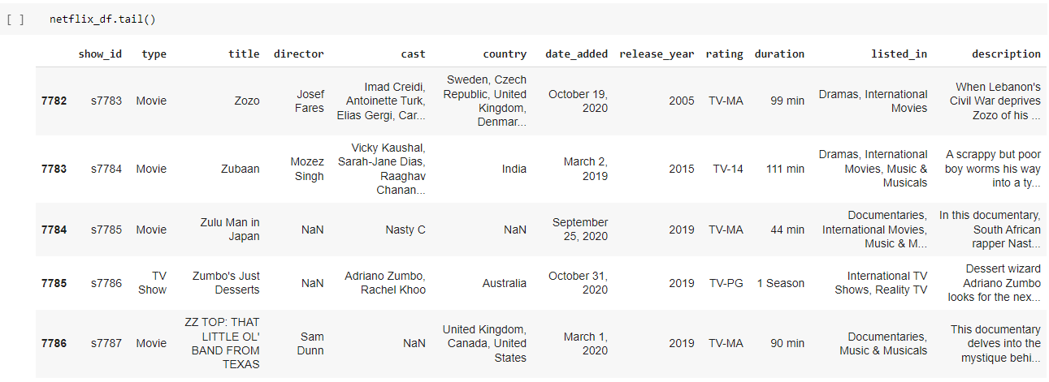
DATA SUMMARY
This Dataset contains 7786 lines and 12 columns.
One categorical features ‘Type’ and Mostly features are object type.
One Date time features ‘date_added’.
We have some object type variables such as show_id, title, Director, cast, country, rating, duration & description.

Slide 5

FEATURE SUMMARY
show_id : Unique ID for every Movie / Tv Show
type : Identifier - A Movie or TV Show
title : Title of the Movie / TV Show
director : Director of the Movie
cast : Actors involved in the movie / show
country : Country where the movie / show was produced
date_added : Date it was added on Netflix
release_year : Actual Release year of the movie / show
rating : TV Rating of the movie / show
duration : Total Duration - in minutes or number of seasons
listed_in : Genere
description: The Summary description

Slide 6

ANALYSIS OF OUR DATASET
There are some Missing Values present
There are No Duplicate values present
There are some null values present.
And ﬁnally we have ‘type' variable which we need to predict for new observations
The dataset shows ‘type’ data for count of movies and shows (which is 5377 movies and 2410 shows ).we consider this as a single ‘type’ data
So the ‘United States’ is the country which had produce most Country Wise Content on Netflix‘ which is around 48%
And the most Ratings of shows in Netflix is ‘TV-MA‘ which is around 37%
And In the Year 2018 the most Content Release on Netflix
And the most Popular Genres on Netflix is Documentaries

Slide 7
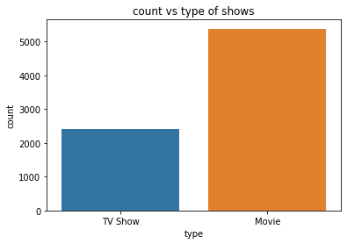
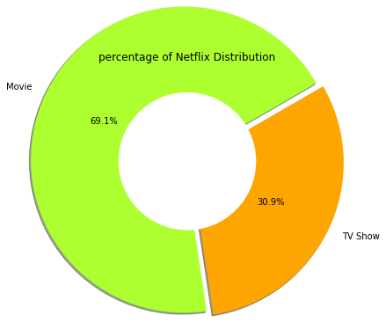
ANALYSIS OF TYPE COLUMN
The above graph shows that the count of Movies is almost double of TV Shows.
The above Donut plot shows the Distribution of Movies and TV Shows Percentage wise

Slide 8
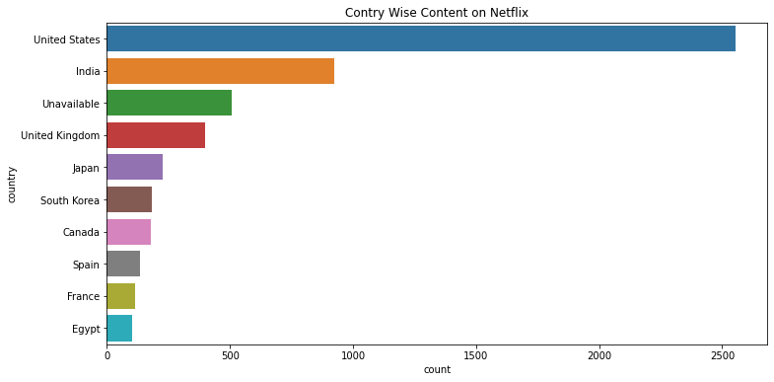
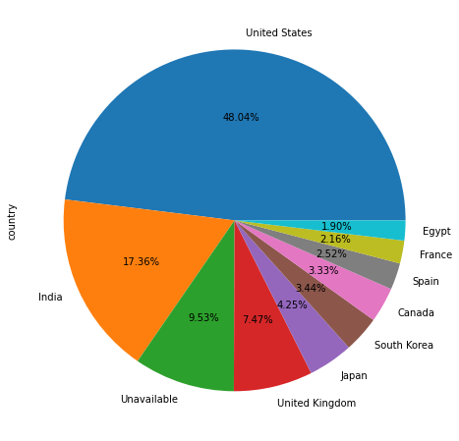
ANALYSIS OF COUNTRY WISE CONTENT
The above plot shows the country wise content on Netflix that is United state which is the most number of content on Netflix.
The most percentage count of country wise content is 48% which is of United State

Slide 9
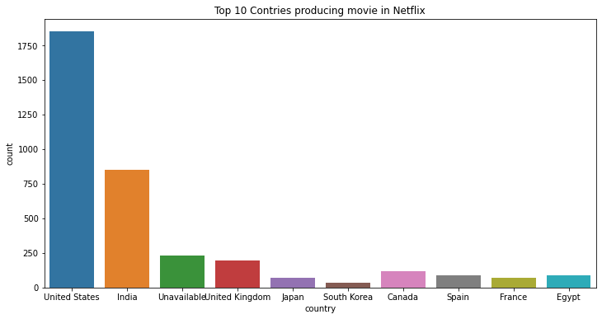
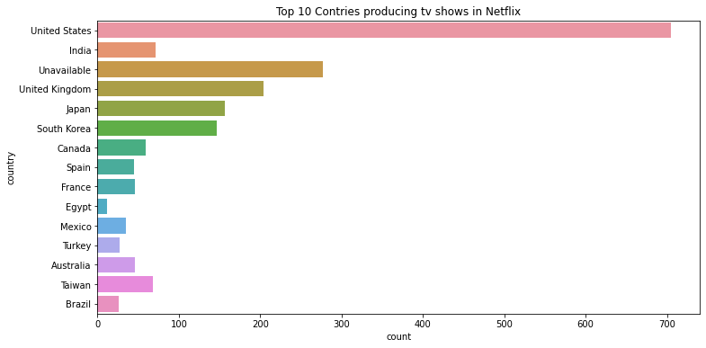
ANALYSIS OF MOVIES & SHOWS
From the above plot we can clearly say that the United State is the Top most country which will produce Movies on Netflix
From the above plot we can clearly say that the United State is the Top most country which will produce Shows on Netflix

Slide 10
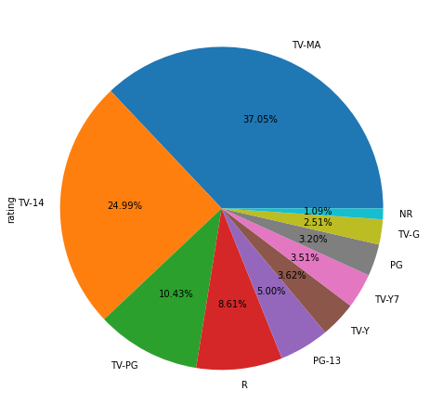
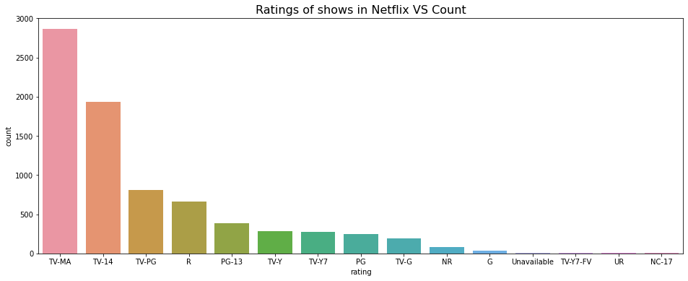
ANALYSIS OF RATINGS
From the above Count plot we can say That the top most Ratings of Shows is TV-MA and the second most Ratings of Shows is TV-14
The percentage of TV-MA Ratings of Shows is 37% and the TV-14 Percentage is 25%

Slide 11
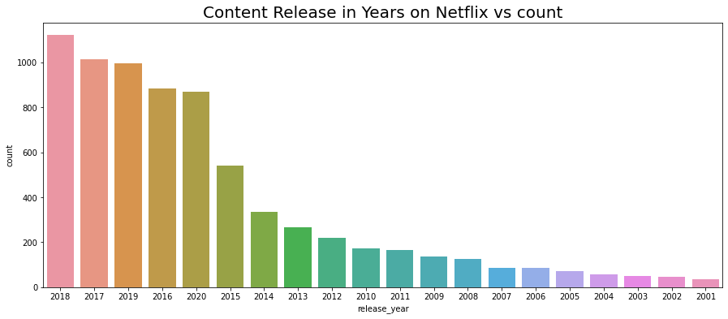
ANALYSIS OF RELEASE YEAR
In the above plot which shows the Most Content release in years is 2018
and the least number of content in Years is 2001

Slide 12
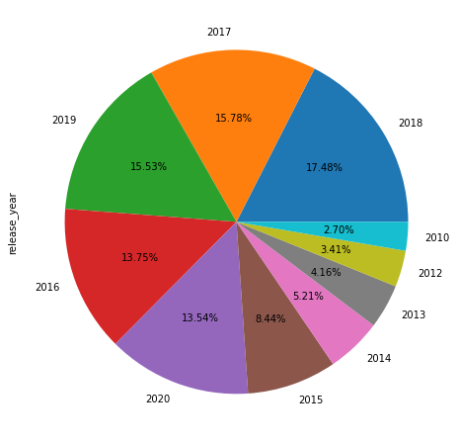
ANALYSIS OF RELEASE YEAR
The above pie plot shows the distribution of Release Year
And we are clearly see that that year 2018 is most Release Year
And the other Release year Distribution is show by the pie plot

Slide 13
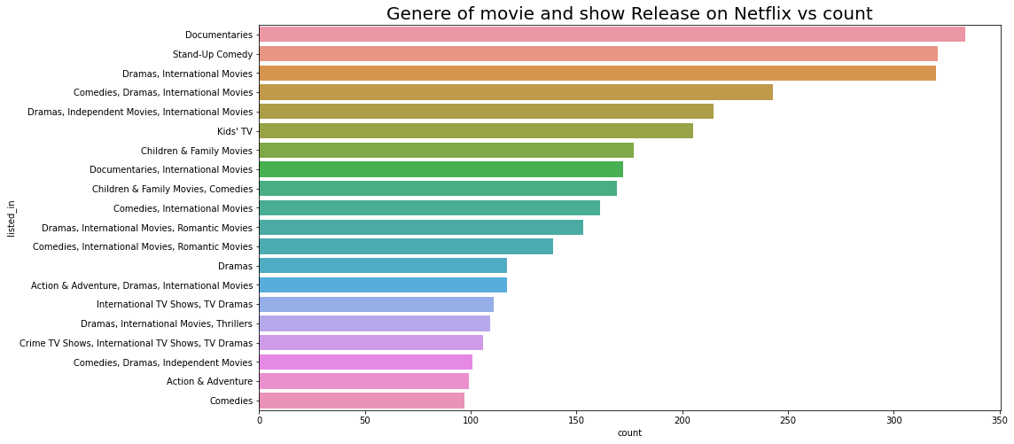
ANALYSIS OF GENERE
In the above count plot shows that the Top most Genere is Documentaries
& the minimum Genere is Comedies

Slide 14
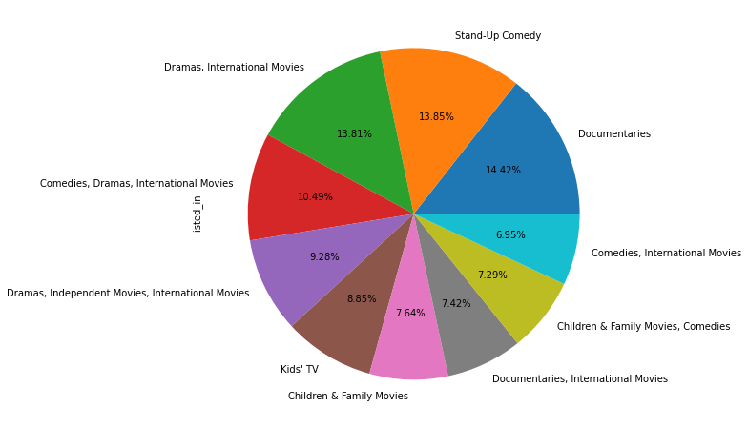
PERCENTAGE WISE GENERE
From the above plot we see that Most percentage of Genere is Documentaries which is aprox. 14%
And the Least percentage of Genere is Comedis, International Movies which is aprox. 7%

Slide 15
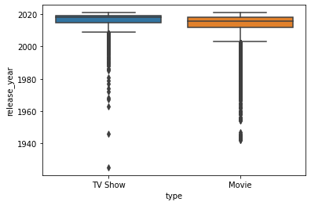
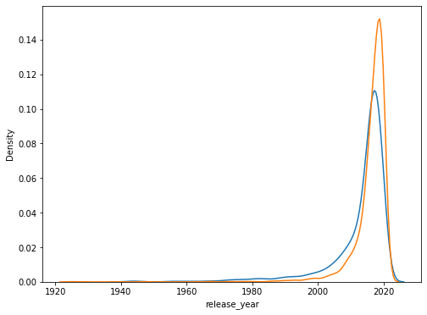
CORRELATION MATRIX
So here we clearly say that the maximum production of TV Shows is Between of year 2000 to 2020
and the production of TV Shows is greater than Movies in years 2000 to 2020

Slide 16
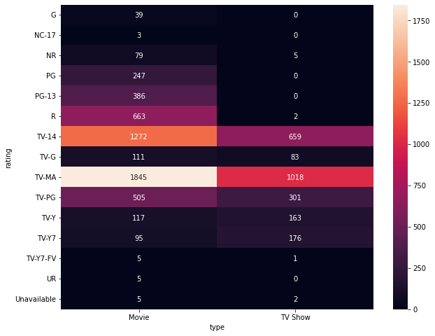
RATINGS VS TYPE
So.. through the histogram we clearly see that the maximum rating of Movie category is TV-MA which is 1845
and the maximum rating of TV Show is TV-MA which is 1018

Slide 17
CHALLENGES
Large Dataset to handle.
Needs to plot lot of Graphs to analyze.
Difficult to analyze and create relationship between them.
Feature selection

Slide 18
CONCLUSIONS
Netflix has more movies than tv shows
Most number of Movies and tv Shows are produced by United States, followed by india who has produced the second most number of Movies on Netflix
Most of the content on Netflix(Movies and TV Shows combine) is for Mature Audience
2018 is the Year in which Netflix released lot more content to other Years
International Movies and Dramas are the most popular Genere on Netflix
the maximum production of TV Shows is Between of year 2000 to 2020 and the production of TV Shows is greater than Movies in years 2000 to 2020
The maximum show produced by country is India
The Maximum Movie produced by any country is South Korea
through the histogram we clearly see that the maximum rating of Movie category is TV-MA which is 1845 and the maximum rating of TV Show is TV-MA which is 1018

Slide 19
THANK YOU

